Slide 1
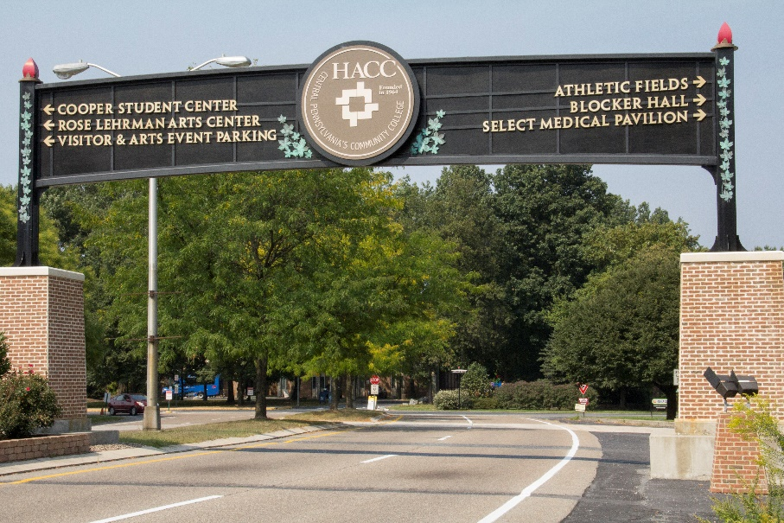
In Person Fall Harrisburg Transfer Fair
Wednesday, Oct. 19 from 10:30 – 1:30 p.m.
Thinking about transferring? Want to meet with some transfer reps to talk about transferring and the application process? Learn about scholarships? Join us to get all of your transfer questions answered by Transfer Services and multiple transfer partner representatives from colleges waiting to speak with you one-on-one about their transfer opportunities.
Where: Harrisburg Cooper 102A/L/W Lobby Fireplace
All HACC students considering transferring to a 4-year college or university
Sponsored and hosted by Career Development and Transfer Services

